Slide 1


CSC212: Data Structures

Slide 2

 Consider the search operation FindKey: find an element of a particular key value in a binary tree.
In binary tree this operation is O(n).
In a binary tree of 10⁶ nodes → 10⁶ steps
required.
In a Binary Search Tree (BST) this operation can be performed very efficiently: O(log₂n).
A binary search tree of 10⁶ nodes → log₂(10⁶) ≅
20 steps only are required.

Slide 3
 A Binary Search Tree (BST) is a binary tree such that for each node, say N, the following statements are true:
If L is any node in the left subtree of N, then L is less than N.
If R is any node in the right subtree of N, then R
is greater than N.

Slide 4
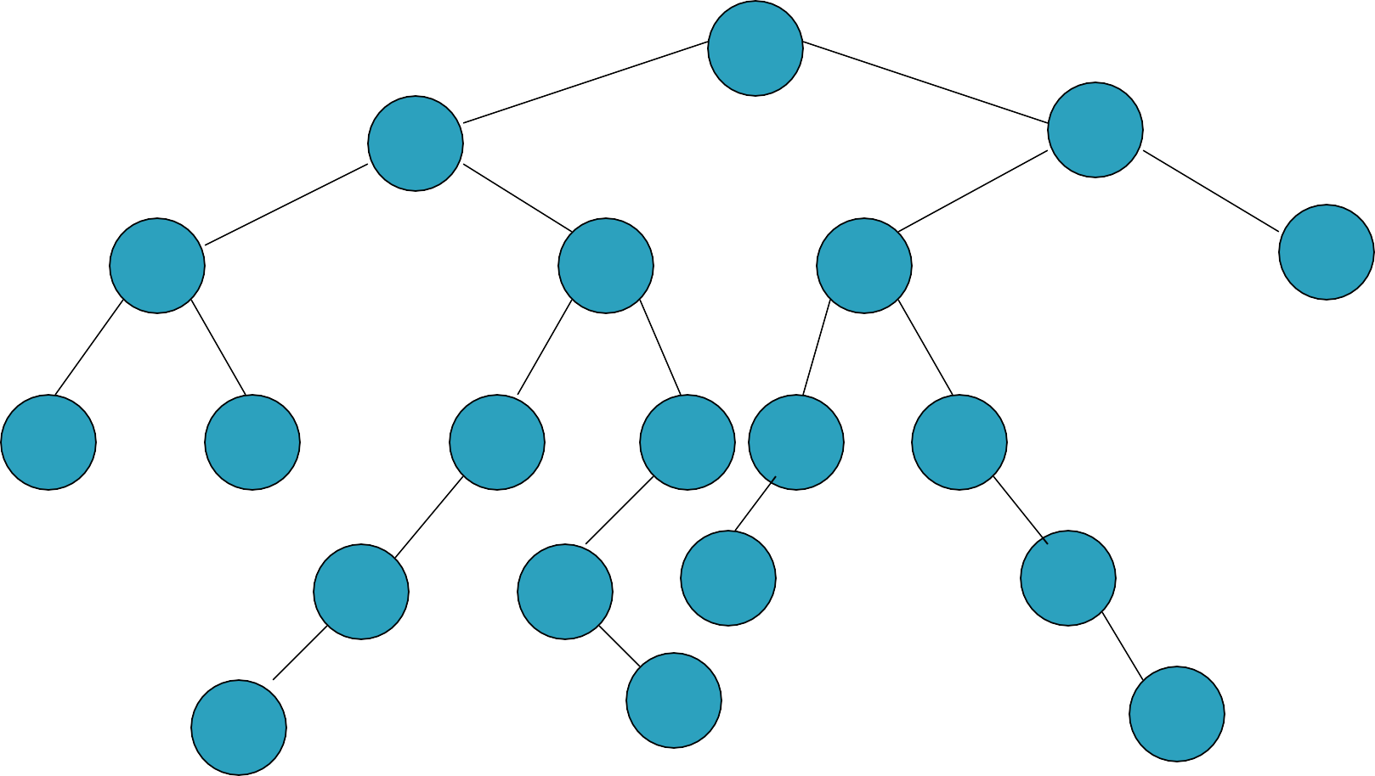
65
35
91
14
53
73
93
0
33
50
58 71
80
44
55
69
81
56
87
40

Slide 5

Elements: the elements are nodes (BSTNode), each node contains the following data type: Type.
Structure: hierarchical structure; each node can have two children: left or right child; there is a root node and a current node. If N is any node in the tree, nodes in the left subtree < N and nodes in the right subtree
> N.
Domain: the number of nodes in a BST is
bounded; type/class name is BST

Slide 6
Operations:
1. Method FindKey (int tkey, boolean found). requires: none.
input: tkey.
results: If bst contains a node whose key value is tkey, then that node is made the current node and found is set to true; otherwise found is set to false and either the tree is empty or the current node is the node to which the node with key = tkey would be attached as a child if it were added to the BST.
output: found.

Slide 7
Method Insert (int k, Type e, boolean inserted) requires: Full (bst) is false. input: key, e.
results: if bst does not contain k then inserted is set to true and node with k and e is inserted and made the current element; otherwise inserted is set to false and current value does not change. output: inserted.
Method Remove_Key (int tkey, boolean removed)
input: tkey
results: Node with key value tkey is removed from the bst and removed set to true. If BST is not empty then root is made the current. output: removed

Slide 8
Method Update(int key, Type e, boolean updated)
requires: Empty(bst) is false. input: key, e. results: current node’s element is replaced with e. Output: updated.
These operations have the same specification
as ADT Binary Tree.
Method Traverse (Order ord)
Method DeleteSub ( )
Method Retrieve (Type e)
Method Empty ( boolean empty ).

Slide 9
9. Method Full (boolean full)

Slide 10
public class BSTNode <T> { public int key;
public T data;
public BSTNode<T> left, right;
/** Creates a new instance of BSTNode */ public BSTNode(int k, T val) {
key = k;
data = val;
left = right = null;
}
public BSTNode(int k, T val, BSTNode<T> l, BSTNode<T> r) { key = k;
data = val; left = l;
right = r;
}
}

Slide 11
public class BST <T> { BSTNode<T> root, current;
/** Creates a new instance of BST */
public BST() {
root = current = null;
}
public boolean empty() {
return root == null;
}
public boolean full() { return false;
}
public T retrieve () { return current.data;
}

Slide 12
public class BST <T> { BSTNode<T> root, current;
R C
/** Creates a new instance of BST */
public BST() {
root = current = null;
}
null
public boolean empty() {
return root == null;
}
public boolean full() { return false;
}
public T retrieve () { return current.data;
}

Slide 13
public class BST <T> { BSTNode<T> root, current;
R C
null true
/** Creates a new instance of BST */
public BST() {
root = current = null;
}
public boolean empty() {
return root == null;
}
R
7
C
public boolean full() { return false;
}
5
9
public T retrieve () { return current.data;
}
3
6
false

Slide 14
public class BST <T> { BSTNode<T> root, current;
/** Creates a new instance of BST */
public BST() {
root = current = null;
}
R
7
C
public boolean empty() {
return root == null;
}
5
9
public boolean full() { return false;
}
3
6
public T retrieve () { return current.data;
}

Slide 15

 The search operation in a binary search tree
can be carried out as:
While (the target element is not found and there is more tree to search) do
if the target element is “less than” the current element then search the left subtree else search the right subtree.

Slide 16
public boolean findkey(int tkey) { BSTNode<T> p = root,q = root;
if(empty())
return false;
while(p != null) {
q = p;
if(p.key == tkey) {
current = p;
return true;
}
else if(tkey < p.key)
p = p.left;
else
p = p.right;
}
current = q; return false;
}

Slide 17
Example #1
tkey = 60
public boolean findkey(int tkey) { BSTNode<T> p = root,q = root;
if(empty())
return false;
R
while(p != null) {
q = p;
if(p.key == tkey) {
current = p;
return true;
}
else if(tkey < p.key)
p = p.left;
else
p = p.right;
}
60
20
70
C
10
30
110
50 90
current = q; return false;
40
100
}

Slide 18
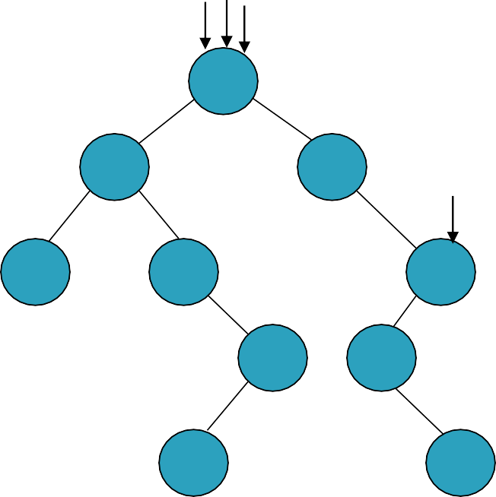
Example #1
tkey = 60
public boolean findkey(int tkey) { BSTNode<T> p = root,q = root;
if(empty())
return false;
R PQ
while(p != null) {
q = p;
if(p.key == tkey) {
current = p;
return true;
}
else if(tkey < p.key)
p = p.left;
else
p = p.right;
}
60
20
70
C
10
30
110
50 90
current = q; return false;
40
100
}

Slide 19
Example #1
tkey = 60
public boolean findkey(int tkey) { BSTNode<T> p = root,q = root;
if(empty())
return false;
R PQ
while(p != null) {
q = p;
if(p.key == tkey) {
current = p;
return true;
}
else if(tkey < p.key)
p = p.left;
else
p = p.right;
}
60
20
70
C
10
30
110
50 90
current = q; return false;
40
100
}

Slide 20
Example #1
tkey = 60
public boolean findkey(int tkey) { BSTNode<T> p = root,q = root;
if(empty())
return false;
R PQ
while(p != null) {
q = p;
if(p.key == tkey) {
current = p;
return true;
}
else if(tkey < p.key)
p = p.left;
else
p = p.right;
}
60
20
70
C
10
30
110
50 90
current = q; return false;
40
100
}

Slide 21
Example #1
tkey = 60
public boolean findkey(int tkey) { BSTNode<T> p = root,q = root;
if(empty())
return false;
R PQ
while(p != null) {
q = p;
if(p.key == tkey) {
current = p;
return true;
}
else if(tkey < p.key)
p = p.left;
else
p = p.right;
}
60
20
70
C
10
30
110
50 90
current = q; return false;
40
100
}

Slide 22
Example #1
tkey = 60
public boolean findkey(int tkey) { BSTNode<T> p = root,q = root;
if(empty())
return false;
R PQ
while(p != null) {
q = p;
if(p.key == tkey) {
current = p;
return true;
}
else if(tkey < p.key)
p = p.left;
else
p = p.right;
}
60
20
70
C
10
30
110
50 90
current = q; return false;
40
100
}

Slide 23
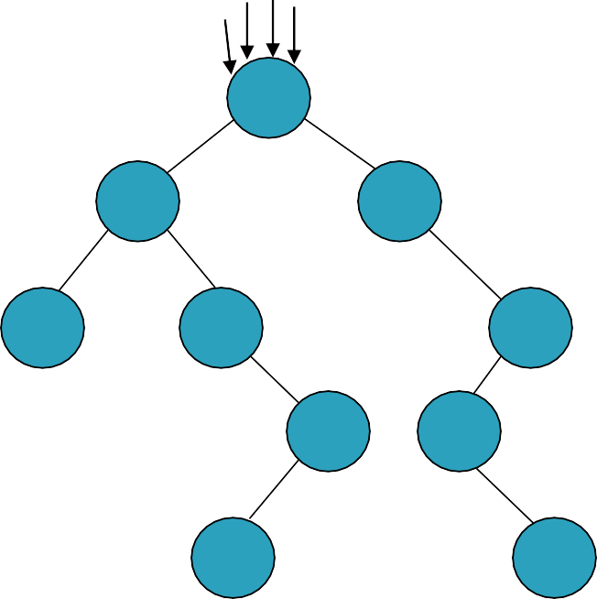
Example #1
tkey = 60
public boolean findkey(int tkey) { BSTNode<T> p = root,q = root;
if(empty())
return false;
_{C}R PQ
while(p != null) {
q = p;
if(p.key == tkey) {
current = p;
return true;
}
else if(tkey < p.key)
p = p.left;
else
p = p.right;
}
60
20
70
10
30
110
50 90
current = q; return false;
40
100
}

Slide 24
Example #1
tkey = 60
public boolean findkey(int tkey) { BSTNode<T> p = root,q = root;
if(empty())
return false;
_{C}R
while(p != null) {
q = p;
if(p.key == tkey) {
current = p;
return true;
}
else if(tkey < p.key)
p = p.left;
else
p = p.right;
}
60
20
70
10
30
110
50 90
current = q; return false;
40
100
}

Slide 25
Example #2
tkey = 30
public boolean findkey(int tkey) { BSTNode<T> p = root,q = root;
if(empty())
return false;
R
while(p != null) {
q = p;
if(p.key == tkey) {
current = p;
return true;
}
else if(tkey < p.key)
p = p.left;
else
p = p.right;
}
60
20
70
C
10
30
110
50 90
current = q; return false;
40
100
}

Slide 26
Example #2
tkey = 30
public boolean findkey(int tkey) { BSTNode<T> p = root,q = root;
if(empty())
return false;
R PQ
while(p != null) {
q = p;
if(p.key == tkey) {
current = p;
return true;
}
else if(tkey < p.key)
p = p.left;
else
p = p.right;
}
60
20
70
C
10
30
110
50 90
current = q; return false;
40
100
}

Slide 27
Example #2
tkey = 30
public boolean findkey(int tkey) { BSTNode<T> p = root,q = root;
if(empty())
return false;
R PQ
while(p != null) {
q = p;
if(p.key == tkey) {
current = p;
return true;
}
else if(tkey < p.key)
p = p.left;
else
p = p.right;
}
60
20
70
C
10
30
110
50 90
current = q; return false;
40
100
}

Slide 28
Example #2
tkey = 30
public boolean findkey(int tkey) { BSTNode<T> p = root,q = root;
if(empty())
return false;
R PQ
while(p != null) {
q = p;
if(p.key == tkey) {
current = p;
return true;
}
else if(tkey < p.key)
p = p.left;
else
p = p.right;
}
60
20
70
C
10
30
110
50 90
current = q; return false;
40
100
}

Slide 29
Example #2
tkey = 30
public boolean findkey(int tkey) { BSTNode<T> p = root,q = root;
if(empty())
return false;
R PQ
while(p != null) {
q = p;
if(p.key == tkey) {
current = p;
return true;
}
else if(tkey < p.key)
p = p.left;
else
p = p.right;
}
60
20
70
C
10
30
110
50 90
current = q; return false;
40
100
}

Slide 30
Example #2
tkey = 30
public boolean findkey(int tkey) { BSTNode<T> p = root,q = root;
if(empty())
return false;
R PQ
while(p != null) {
q = p;
if(p.key == tkey) {
current = p;
return true;
}
else if(tkey < p.key)
p = p.left;
else
p = p.right;
}
60
20
70
C
10
30
110
50 90
current = q; return false;
40
100
}

Slide 31
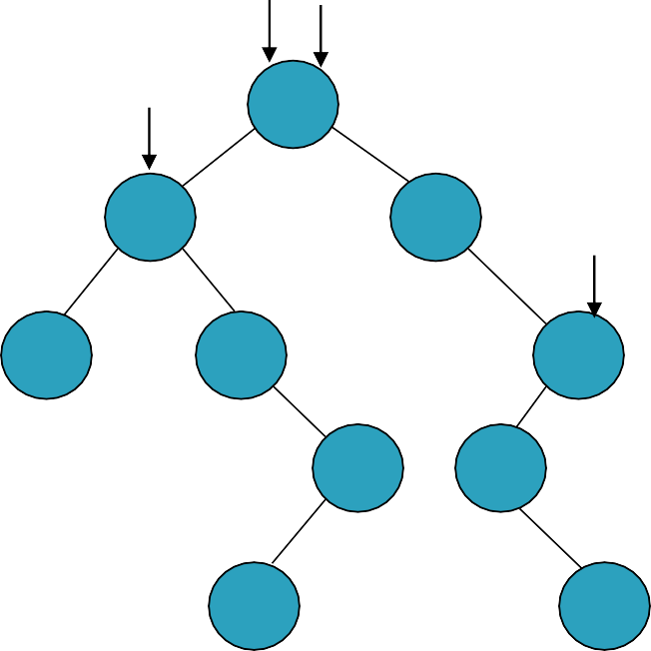
Example #2
tkey = 30
public boolean findkey(int tkey) { BSTNode<T> p = root,q = root;
if(empty())
return false;
R
Q
while(p != null) {
q = p;
if(p.key == tkey) {
current = p;
return true;
}
else if(tkey < p.key)
p = p.left;
else
p = p.right;
}
P
60
20
70
C
10
30
110
50 90
current = q; return false;
40
100
}

Slide 32
Example #2
tkey = 30
public boolean findkey(int tkey) { BSTNode<T> p = root,q = root;
if(empty())
return false;
R
Q
while(p != null) {
q = p;
if(p.key == tkey) {
current = p;
return true;
}
else if(tkey < p.key)
p = p.left;
else
p = p.right;
}
P
60
20
70
C
10
30
110
50 90
current = q; return false;
40
100
}

Slide 33

Example #2
tkey = 30
public boolean findkey(int tkey) { BSTNode<T> p = root,q = root;
if(empty())
return false;
R
while(p != null) {
q = p;
if(p.key == tkey) {
current = p;
return true;
}
else if(tkey < p.key)
p = p.left;
else
p = p.right;
}
PQ
60
20
70
C
10
30
110
50 90
current = q; return false;
40
100
}

Slide 34
Example #2
tkey = 30
public boolean findkey(int tkey) { BSTNode<T> p = root,q = root;
if(empty())
return false;
R
while(p != null) {
q = p;
if(p.key == tkey) {
current = p;
return true;
}
else if(tkey < p.key)
p = p.left;
else
p = p.right;
}
PQ
60
20
70
C
10
30
110
50 90
current = q; return false;
40
100
}

Slide 35
Example #2
tkey = 30
public boolean findkey(int tkey) { BSTNode<T> p = root,q = root;
if(empty())
return false;
R
while(p != null) {
q = p;
if(p.key == tkey) {
current = p;
return true;
}
else if(tkey < p.key)
p = p.left;
else
p = p.right;
}
PQ
60
20
70
C
10
30
110
50 90
current = q; return false;
40
100
}

Slide 36
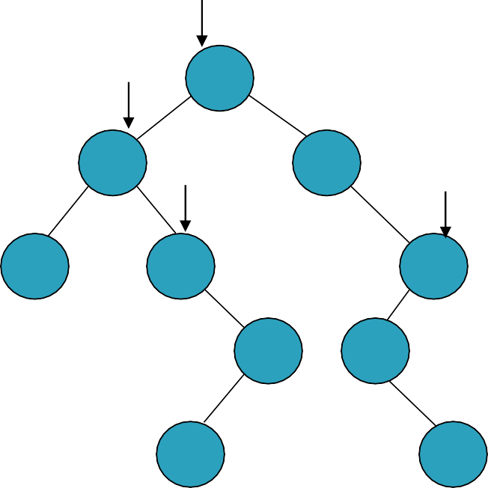
Example #2
tkey = 30
public boolean findkey(int tkey) { BSTNode<T> p = root,q = root;
if(empty())
return false;
R
while(p != null) {
q = p;
if(p.key == tkey) {
current = p;
return true;
}
else if(tkey < p.key)
p = p.left;
else
p = p.right;
}
Q
60
20
P
70
C
10
30
110
50 90
current = q; return false;
40
100
}

Slide 37
Example #2
tkey = 30
public boolean findkey(int tkey) { BSTNode<T> p = root,q = root;
if(empty())
return false;
R
while(p != null) {
q = p;
if(p.key == tkey) {
current = p;
return true;
}
else if(tkey < p.key)
p = p.left;
else
p = p.right;
}
Q
60
20
P
70
C
10
30
110
50 90
current = q; return false;
40
100
}

Slide 38
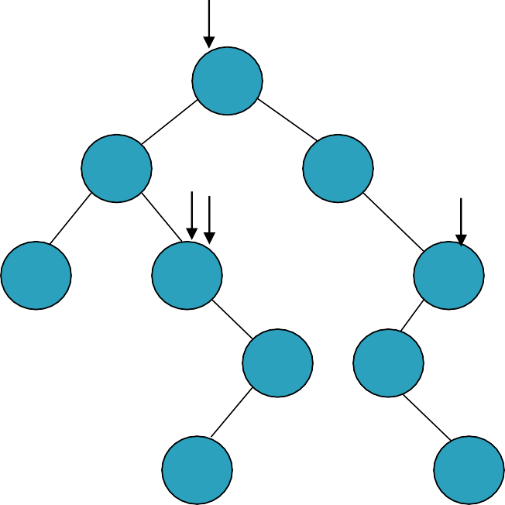
Example #2
tkey = 30
public boolean findkey(int tkey) { BSTNode<T> p = root,q = root;
if(empty())
return false;
R
while(p != null) {
q = p;
if(p.key == tkey) {
current = p;
return true;
}
else if(tkey < p.key)
p = p.left;
else
p = p.right;
}
60
20
PQ
70
C
10
30
110
50 90
current = q; return false;
40
100
}

Slide 39
Example #2
tkey = 30
public boolean findkey(int tkey) { BSTNode<T> p = root,q = root;
if(empty())
return false;
R
while(p != null) {
q = p;
if(p.key == tkey) {
current = p;
return true;
}
else if(tkey < p.key)
p = p.left;
else
p = p.right;
}
60
20
PQ
70
C
10
30
110
50 90
current = q; return false;
40
100
}

Slide 40
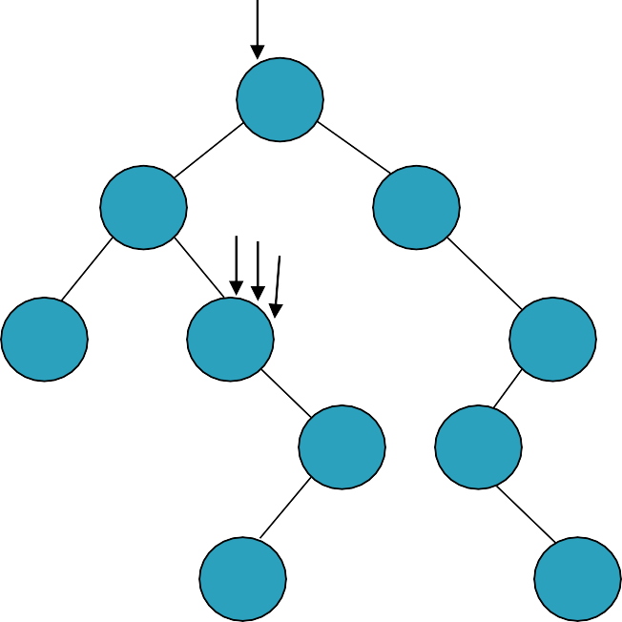
Example #2
tkey = 30
public boolean findkey(int tkey) { BSTNode<T> p = root,q = root;
if(empty())
return false;
R
while(p != null) {
q = p;
if(p.key == tkey) {
current = p;
return true;
}
else if(tkey < p.key)
p = p.left;
else
p = p.right;
}
60
20
PQ
70
C
10
30
110
50 90
current = q; return false;
40
100
}

Slide 41
Example #2
tkey = 30
public boolean findkey(int tkey) { BSTNode<T> p = root,q = root;
if(empty())
return false;
R
while(p != null) {
q = p;
if(p.key == tkey) {
current = p;
return true;
}
else if(tkey < p.key)
p = p.left;
else
p = p.right;
}
60
20
70
C
10
30
110
50 90
current = q; return false;
40
100
}

Slide 42
Example #3
tkey = 90
public boolean findkey(int tkey) { BSTNode<T> p = root,q = root;
if(empty())
return false;
R
while(p != null) {
q = p;
if(p.key == tkey) {
current = p;
return true;
}
else if(tkey < p.key)
p = p.left;
else
p = p.right;
}
60
20
70
C
10
30
110
50 90
current = q; return false;
40
100
}

Slide 43
Example #3
tkey = 90
public boolean findkey(int tkey) { BSTNode<T> p = root,q = root;
if(empty())
return false;
R PQ
while(p != null) {
q = p;
if(p.key == tkey) {
current = p;
return true;
}
else if(tkey < p.key)
p = p.left;
else
p = p.right;
}
60
20
70
C
10
30
110
50 90
current = q; return false;
40
100
}

Slide 44
Example #3
tkey = 90
public boolean findkey(int tkey) { BSTNode<T> p = root,q = root;
if(empty())
return false;
R PQ
while(p != null) {
q = p;
if(p.key == tkey) {
current = p;
return true;
}
else if(tkey < p.key)
p = p.left;
else
p = p.right;
}
60
20
70
C
10
30
110
50 90
current = q; return false;
40
100
}

Slide 45
Example #3
tkey = 90
public boolean findkey(int tkey) { BSTNode<T> p = root,q = root;
if(empty())
return false;
R PQ
while(p != null) {
q = p;
if(p.key == tkey) {
current = p;
return true;
}
else if(tkey < p.key)
p = p.left;
else
p = p.right;
}
60
20
70
C
10
30
110
50 90
current = q; return false;
40
100
}

Slide 46

Example #3
tkey = 90
public boolean findkey(int tkey) { BSTNode<T> p = root,q = root;
if(empty())
return false;
R
Q
while(p != null) {
q = p;
if(p.key == tkey) {
current = p;
return true;
}
else if(tkey < p.key)
p = p.left;
else
p = p.right;
}
60
P
20
70
C
10
30
110
50 90
current = q; return false;
40
100
}

Slide 47
Example #3
tkey = 90
public boolean findkey(int tkey) { BSTNode<T> p = root,q = root;
if(empty())
return false;
R
Q
while(p != null) {
q = p;
if(p.key == tkey) {
current = p;
return true;
}
else if(tkey < p.key)
p = p.left;
else
p = p.right;
}
60
P
20
70
C
10
30
110
50 90
current = q; return false;
40
100
}

Slide 48
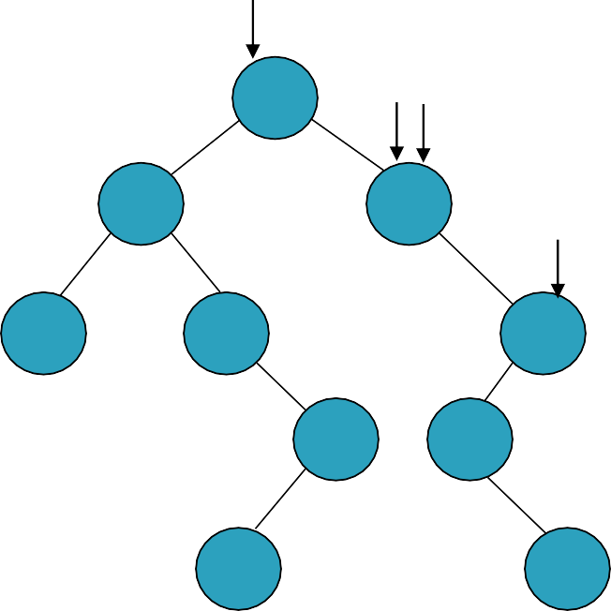
Example #3
tkey = 90
public boolean findkey(int tkey) { BSTNode<T> p = root,q = root;
if(empty())
return false;
R
while(p != null) {
q = p;
if(p.key == tkey) {
current = p;
return true;
}
else if(tkey < p.key)
p = p.left;
else
p = p.right;
}
60
Q P
20
70
C
10
30
110
50 90
current = q; return false;
40
100
}

Slide 49
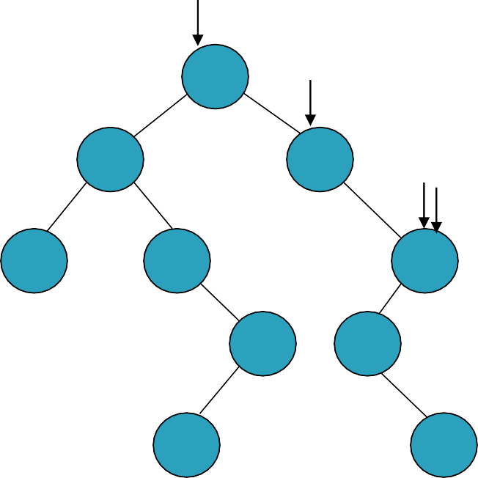
Example #3
tkey = 90
public boolean findkey(int tkey) { BSTNode<T> p = root,q = root;
if(empty())
return false;
R
while(p != null) {
q = p;
if(p.key == tkey) {
current = p;
return true;
}
else if(tkey < p.key)
p = p.left;
else
p = p.right;
}
60
Q
20
70
P_{C}
10
30
110
50 90
current = q; return false;
40
100
}

Slide 50
Example #3
tkey = 90
public boolean findkey(int tkey) { BSTNode<T> p = root,q = root;
if(empty())
return false;
R
while(p != null) {
q = p;
if(p.key == tkey) {
current = p;
return true;
}
else if(tkey < p.key)
p = p.left;
else
p = p.right;
}
60
Q
20
70
P_{C}
10
30
110
50 90
current = q; return false;
40
100
}

Slide 51
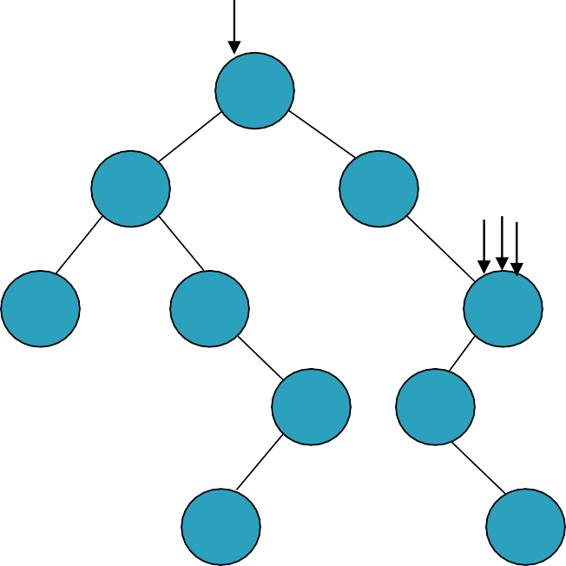
Example #3
tkey = 90
public boolean findkey(int tkey) { BSTNode<T> p = root,q = root;
if(empty())
return false;
R
while(p != null) {
q = p;
if(p.key == tkey) {
current = p;
return true;
}
else if(tkey < p.key)
p = p.left;
else
p = p.right;
}
60
20
70
QP_{C}
10
30
110
50 90
current = q; return false;
40
100
}

Slide 52
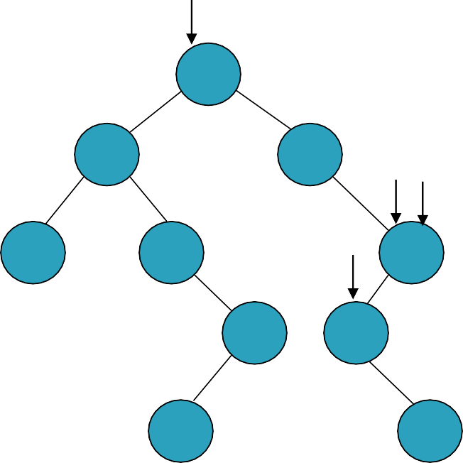
Example #3
tkey = 90
public boolean findkey(int tkey) { BSTNode<T> p = root,q = root;
if(empty())
return false;
R
while(p != null) {
q = p;
if(p.key == tkey) {
current = p;
return true;
}
else if(tkey < p.key)
p = p.left;
else
p = p.right;
}
60
20
70
Q C
10
30
P
110
50 90
current = q; return false;
40
100
}

Slide 53
Example #3
tkey = 90
public boolean findkey(int tkey) { BSTNode<T> p = root,q = root;
if(empty())
return false;
R
while(p != null) {
q = p;
if(p.key == tkey) {
current = p;
return true;
}
else if(tkey < p.key)
p = p.left;
else
p = p.right;
}
60
20
70
Q C
10
30
P
110
50 90
current = q; return false;
40
100
}

Slide 54
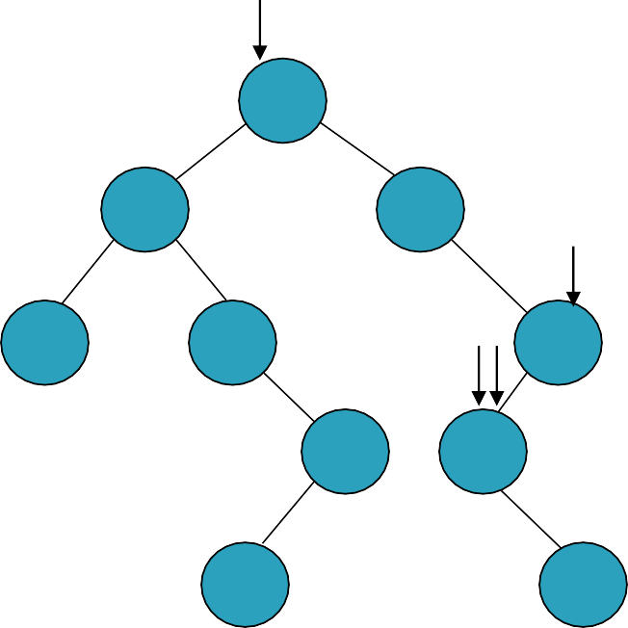
Example #3
tkey = 90
public boolean findkey(int tkey) { BSTNode<T> p = root,q = root;
if(empty())
return false;
R
while(p != null) {
q = p;
if(p.key == tkey) {
current = p;
return true;
}
else if(tkey < p.key)
p = p.left;
else
p = p.right;
}
60
20
70
C
10
30
^{PQ} 110
50 90
current = q; return false;
40
100
}

Slide 55
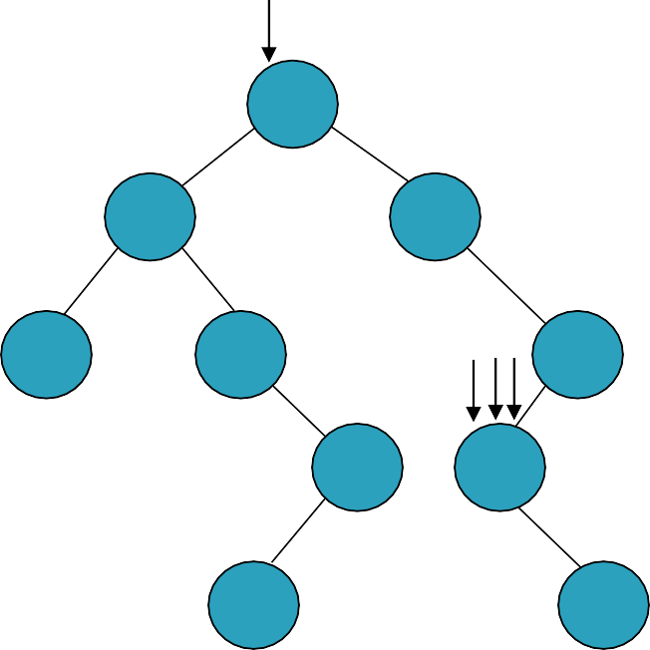
Example #3
tkey = 90
public boolean findkey(int tkey) { BSTNode<T> p = root,q = root;
if(empty())
return false;
R
while(p != null) {
q = p;
if(p.key == tkey) {
current = p;
return true;
}
else if(tkey < p.key)
p = p.left;
else
p = p.right;
}
60
20
70
10
30
^{CPQ} 110
50 90
current = q; return false;
40
100
}

Slide 56
Example #4
tkey = 25
public boolean findkey(int tkey) { BSTNode<T> p = root,q = root;
if(empty())
return false;
R
while(p != null) {
q = p;
if(p.key == tkey) {
current = p;
return true;
}
else if(tkey < p.key)
p = p.left;
else
p = p.right;
}
60
20
70
C
10
30
110
50 90
current = q; return false;
40
100
}

Slide 57

Example #4
tkey = 25
public boolean findkey(int tkey) { BSTNode<T> p = root,q = root;
if(empty())
return false;
R PQ
while(p != null) {
q = p;
if(p.key == tkey) {
current = p;
return true;
}
else if(tkey < p.key)
p = p.left;
else
p = p.right;
}
60
20
70
C
10
30
110
50 90
current = q; return false;
40
100
}

Slide 58
Example #4
tkey = 25
public boolean findkey(int tkey) { BSTNode<T> p = root,q = root;
if(empty())
return false;
R PQ
while(p != null) {
q = p;
if(p.key == tkey) {
current = p;
return true;
}
else if(tkey < p.key)
p = p.left;
else
p = p.right;
}
60
20
70
C
10
30
110
50 90
current = q; return false;
40
100
}

Slide 59
Example #4
tkey = 25
public boolean findkey(int tkey) { BSTNode<T> p = root,q = root;
if(empty())
return false;
R PQ
while(p != null) {
q = p;
if(p.key == tkey) {
current = p;
return true;
}
else if(tkey < p.key)
p = p.left;
else
p = p.right;
}
60
20
70
C
10
30
110
50 90
current = q; return false;
40
100
}

Slide 60

Example #4
tkey = 25
public boolean findkey(int tkey) { BSTNode<T> p = root,q = root;
if(empty())
return false;
R
Q
while(p != null) {
q = p;
if(p.key == tkey) {
current = p;
return true;
}
else if(tkey < p.key)
p = p.left;
else
p = p.right;
}
P
60
20
70
C
10
30
110
50 90
current = q; return false;
40
100
}

Slide 61
Example #4
tkey = 25
public boolean findkey(int tkey) { BSTNode<T> p = root,q = root;
if(empty())
return false;
R
Q
while(p != null) {
q = p;
if(p.key == tkey) {
current = p;
return true;
}
else if(tkey < p.key)
p = p.left;
else
p = p.right;
}
P
60
20
70
C
10
30
110
50 90
current = q; return false;
40
100
}

Slide 62

Example #4
tkey = 25
public boolean findkey(int tkey) { BSTNode<T> p = root,q = root;
if(empty())
return false;
R
while(p != null) {
q = p;
if(p.key == tkey) {
current = p;
return true;
}
else if(tkey < p.key)
p = p.left;
else
p = p.right;
}
QP
60
20
70
C
10
30
110
50 90
current = q; return false;
40
100
}

Slide 63

Example #4
tkey = 25
public boolean findkey(int tkey) { BSTNode<T> p = root,q = root;
if(empty())
return false;
R
while(p != null) {
q = p;
if(p.key == tkey) {
current = p;
return true;
}
else if(tkey < p.key)
p = p.left;
else
p = p.right;
}
Q
60
20
P
70
C
10
30
110
50 90
current = q; return false;
40
100
}

Slide 64
Example #4
tkey = 25
public boolean findkey(int tkey) { BSTNode<T> p = root,q = root;
if(empty())
return false;
R
while(p != null) {
q = p;
if(p.key == tkey) {
current = p;
return true;
}
else if(tkey < p.key)
p = p.left;
else
p = p.right;
}
Q
60
20
P
70
C
10
30
110
50 90
current = q; return false;
40
100
}

Slide 65

Example #4
tkey = 25
public boolean findkey(int tkey) { BSTNode<T> p = root,q = root;
if(empty())
return false;
R
while(p != null) {
q = p;
if(p.key == tkey) {
current = p;
return true;
}
else if(tkey < p.key)
p = p.left;
else
p = p.right;
}
60
20
PQ
70
C
10
30
110
50 90
current = q; return false;
40
100
}

Slide 66

Example #4
tkey = 25
public boolean findkey(int tkey) { BSTNode<T> p = root,q = root;
if(empty())
return false;
R
while(p != null) {
q = p;
if(p.key == tkey) {
current = p;
return true;
}
else if(tkey < p.key)
p = p.left;
else
p = p.right;
}
60
20
70
Q
C
10
30
110
P
50 90
current = q; return false;
40
100
}

Slide 67
Example #4
tkey = 25
public boolean findkey(int tkey) { BSTNode<T> p = root,q = root;
if(empty())
return false;
R
while(p != null) {
q = p;
if(p.key == tkey) {
current = p;
return true;
}
else if(tkey < p.key)
p = p.left;
else
p = p.right;
}
60
20
70
Q
C
10
30
110
P
50 90
current = q; return false;
40
100
}

Slide 68

Example #4
tkey = 25
public boolean findkey(int tkey) { BSTNode<T> p = root,q = root;
if(empty())
return false;
R
while(p != null) {
q = p;
if(p.key == tkey) {
current = p;
return true;
}
else if(tkey < p.key)
p = p.left;
else
p = p.right;
}
60
20
CQ
70
10
30
110
P
50 90
current = q; return false;
40
100
}

Slide 69
Example #4
tkey = 25
public boolean findkey(int tkey) { BSTNode<T> p = root,q = root;
if(empty())
return false;
R
while(p != null) {
q = p;
if(p.key == tkey) {
current = p;
return true;
}
else if(tkey < p.key)
p = p.left;
else
p = p.right;
}
60
20
C
70
10
30
110
50 90
current = q; return false;
40
100
}

Slide 70
public boolean insert(int k, T val) { BSTNode<T> p, q = current;
if(findkey(k)) {
current = q; // findkey() modified current return false; // key already in the BST
}
p = new BSTNode<T>(k, val); if (empty()) {
root = current = p;
return true;
}
else {
// current is pointing to parent of the new key if (k < current.key)
current.left = p;
else
current.right = p;
current = p;
return true;
}
}

Slide 71
Example #1
k = 60
public boolean insert(int k, T val) { BSTNode<T> p, q = current;
if(findkey(k)) {
current = q; // findkey() modified current return false; // key already in the BST
C R
}
p = new BSTNode<T>(k, val); if (empty()) {
root = current = p;
return true;
}
else {
// current is pointing to parent of the new key if (k < current.key)
current.left = p;
else
current.right = p;
current = p;
return true;
}
null
}

Slide 72
Example #1
k = 60
public boolean insert(int k, T val) { BSTNode<T> p, q = current;
if(findkey(k)) {
current = q; // findkey() modified current return false; // key already in the BST
C RQ
}
p = new BSTNode<T>(k, val); if (empty()) {
root = current = p;
return true;
}
else {
// current is pointing to parent of the new key if (k < current.key)
current.left = p;
else
current.right = p;
current = p;
return true;
}
null
}

Slide 73
Example #1
k = 60
public boolean insert(int k, T val) { BSTNode<T> p, q = current;
if(findkey(k)) {
current = q; // findkey() modified current return false; // key already in the BST
C RQ
}
p = new BSTNode<T>(k, val); if (empty()) {
root = current = p;
return true;
}
else {
// current is pointing to parent of the new key if (k < current.key)
current.left = p;
else
current.right = p;
current = p;
return true;
}
null
}

Slide 74
Example #1
k = 60
public boolean insert(int k, T val) { BSTNode<T> p, q = current;
if(findkey(k)) {
current = q; // findkey() modified current return false; // key already in the BST
P
C RQ
60
}
p = new BSTNode<T>(k, val); if (empty()) {
root = current = p;
return true;
}
else {
// current is pointing to parent of the new key if (k < current.key)
current.left = p;
else
current.right = p;
current = p;
return true;
}
null
}

Slide 75
Example #1
k = 60
public boolean insert(int k, T val) { BSTNode<T> p, q = current;
if(findkey(k)) {
current = q; // findkey() modified current return false; // key already in the BST
P
C RQ
60
}
p = new BSTNode<T>(k, val); if (empty()) {
root = current = p;
return true;
}
else {
// current is pointing to parent of the new key if (k < current.key)
current.left = p;
else
current.right = p;
current = p;
return true;
}
null
}

Slide 76
Example #1
k = 60
public boolean insert(int k, T val) { BSTNode<T> p, q = current;
if(findkey(k)) {
current = q; // findkey() modified current return false; // key already in the BST
P
C RQ
}
p = new BSTNode<T>(k, val); if (empty()) {
root = current = p;
return true;
}
else {
// current is pointing to parent of the new key if (k < current.key)
current.left = p;
else
current.right = p;
current = p;
return true;
}
60
}

Slide 77
Example #1
k = 60
public boolean insert(int k, T val) { BSTNode<T> p, q = current;
if(findkey(k)) {
current = q; // findkey() modified current return false; // key already in the BST
C R
}
p = new BSTNode<T>(k, val); if (empty()) {
root = current = p;
return true;
}
else {
// current is pointing to parent of the new key if (k < current.key)
current.left = p;
else
current.right = p;
current = p;
return true;
}
60
}

Slide 78
Example #2
k = 20
public boolean insert(int k, T val) { BSTNode<T> p, q = current;
if(findkey(k)) {
current = q; // findkey() modified current return false; // key already in the BST
C R
}
p = new BSTNode<T>(k, val); if (empty()) {
root = current = p;
return true;
}
else {
// current is pointing to parent of the new key if (k < current.key)
current.left = p;
else
current.right = p;
current = p;
return true;
}
60
}

Slide 79
Example #2
k = 20
public boolean insert(int k, T val) { BSTNode<T> p, q = current;
if(findkey(k)) {
current = q; // findkey() modified current return false; // key already in the BST
C RQ
}
p = new BSTNode<T>(k, val); if (empty()) {
root = current = p;
return true;
}
else {
// current is pointing to parent of the new key if (k < current.key)
current.left = p;
else
current.right = p;
current = p;
return true;
}
60
}

Slide 80
Example #2
k = 20
public boolean insert(int k, T val) { BSTNode<T> p, q = current;
if(findkey(k)) {
current = q; // findkey() modified current return false; // key already in the BST
C RQ
}
p = new BSTNode<T>(k, val); if (empty()) {
root = current = p;
return true;
}
else {
// current is pointing to parent of the new key if (k < current.key)
current.left = p;
else
current.right = p;
current = p;
return true;
}
60
}

Slide 81
Example #2
k = 20
public boolean insert(int k, T val) { BSTNode<T> p, q = current;
if(findkey(k)) {
current = q; // findkey() modified current return false; // key already in the BST
C RQ
}
p = new BSTNode<T>(k, val); if (empty()) {
root = current = p;
return true;
}
else {
// current is pointing to parent of the new key if (k < current.key)
current.left = p;
else
current.right = p;
current = p;
return true;
}
P
60
20
}

Slide 82
Example #2
k = 20
public boolean insert(int k, T val) { BSTNode<T> p, q = current;
if(findkey(k)) {
current = q; // findkey() modified current return false; // key already in the BST
C RQ
}
p = new BSTNode<T>(k, val); if (empty()) {
root = current = p;
return true;
}
else {
// current is pointing to parent of the new key if (k < current.key)
current.left = p;
else
current.right = p;
current = p;
return true;
}
P
60
20
}

Slide 83
Example #2
k = 20
public boolean insert(int k, T val) { BSTNode<T> p, q = current;
if(findkey(k)) {
current = q; // findkey() modified current return false; // key already in the BST
C RQ
}
p = new BSTNode<T>(k, val); if (empty()) {
root = current = p;
return true;
}
else {
// current is pointing to parent of the new key if (k < current.key)
current.left = p;
else
current.right = p;
current = p;
return true;
}
P
60
20
}

Slide 84
Example #2
k = 20
public boolean insert(int k, T val) { BSTNode<T> p, q = current;
if(findkey(k)) {
current = q; // findkey() modified current return false; // key already in the BST
C RQ
}
p = new BSTNode<T>(k, val); if (empty()) {
root = current = p;
return true;
}
else {
// current is pointing to parent of the new key if (k < current.key)
current.left = p;
else
current.right = p;
current = p;
return true;
}
P
60
20
}

Slide 85
Example #2
k = 20
public boolean insert(int k, T val) { BSTNode<T> p, q = current;
if(findkey(k)) {
current = q; // findkey() modified current return false; // key already in the BST
RQ
}
p = new BSTNode<T>(k, val); if (empty()) {
root = current = p;
return true;
}
else {
// current is pointing to parent of the new key if (k < current.key)
current.left = p;
else
current.right = p;
current = p;
return true;
}
PC
60
20
}

Slide 86
Example #2
k = 20
public boolean insert(int k, T val) { BSTNode<T> p, q = current;
if(findkey(k)) {
current = q; // findkey() modified current return false; // key already in the BST
R
}
p = new BSTNode<T>(k, val); if (empty()) {
root = current = p;
return true;
}
else {
// current is pointing to parent of the new key if (k < current.key)
current.left = p;
else
current.right = p;
current = p;
return true;
}
C
60
20
}

Slide 87
Example #3
k = 70
public boolean insert(int k, T val) { BSTNode<T> p, q = current;
if(findkey(k)) {
current = q; // findkey() modified current return false; // key already in the BST
R
}
p = new BSTNode<T>(k, val); if (empty()) {
root = current = p;
return true;
}
else {
// current is pointing to parent of the new key if (k < current.key)
current.left = p;
else
current.right = p;
current = p;
return true;
}
C
60
20
}

Slide 88
Example #3
k = 70
public boolean insert(int k, T val) { BSTNode<T> p, q = current;
if(findkey(k)) {
current = q; // findkey() modified current return false; // key already in the BST
R
}
p = new BSTNode<T>(k, val); if (empty()) {
root = current = p;
return true;
}
else {
// current is pointing to parent of the new key if (k < current.key)
current.left = p;
else
current.right = p;
current = p;
return true;
}
Q C
60
20
}

Slide 89
Example #3
k = 70
public boolean insert(int k, T val) { BSTNode<T> p, q = current;
if(findkey(k)) {
current = q; // findkey() modified current return false; // key already in the BST
R
}
p = new BSTNode<T>(k, val); if (empty()) {
root = current = p;
return true;
}
else {
// current is pointing to parent of the new key if (k < current.key)
current.left = p;
else
current.right = p;
current = p;
return true;
}
Q C
60
20
}

Slide 90
Example #3
k = 70
public boolean insert(int k, T val) { BSTNode<T> p, q = current;
if(findkey(k)) {
current = q; // findkey() modified current return false; // key already in the BST
_{C} R
}
Q
60
p = new BSTNode<T>(k, val); if (empty()) {
root = current = p;
return true;
}
else {
// current is pointing to parent of the new key if (k < current.key)
current.left = p;
else
current.right = p;
current = p;
return true;
}
20
}

Slide 91
Example #3
k = 70
public boolean insert(int k, T val) { BSTNode<T> p, q = current;
if(findkey(k)) {
current = q; // findkey() modified current return false; // key already in the BST
_{C} R
}
Q
60
P
p = new BSTNode<T>(k, val); if (empty()) {
root = current = p;
return true;
}
else {
// current is pointing to parent of the new key if (k < current.key)
current.left = p;
else
current.right = p;
current = p;
return true;
}
20
70
}

Slide 92
Example #3
k = 70
public boolean insert(int k, T val) { BSTNode<T> p, q = current;
if(findkey(k)) {
current = q; // findkey() modified current return false; // key already in the BST
_{C} R
}
Q
60
P
p = new BSTNode<T>(k, val); if (empty()) {
root = current = p;
return true;
}
else {
// current is pointing to parent of the new key if (k < current.key)
current.left = p;
else
current.right = p;
current = p;
return true;
}
20
70
}

Slide 93
Example #3
k = 70
public boolean insert(int k, T val) { BSTNode<T> p, q = current;
if(findkey(k)) {
current = q; // findkey() modified current return false; // key already in the BST
_{C} R
}
Q
60
P
p = new BSTNode<T>(k, val); if (empty()) {
root = current = p;
return true;
}
else {
// current is pointing to parent of the new key if (k < current.key)
current.left = p;
else
current.right = p;
current = p;
return true;
}
20
70
}

Slide 94
Example #3
k = 70
public boolean insert(int k, T val) { BSTNode<T> p, q = current;
if(findkey(k)) {
current = q; // findkey() modified current return false; // key already in the BST
_{C} R
}
Q
60
P
p = new BSTNode<T>(k, val); if (empty()) {
root = current = p;
return true;
}
else {
// current is pointing to parent of the new key if (k < current.key)
current.left = p;
else
current.right = p;
current = p;
return true;
}
20
70
}

Slide 95
Example #3
k = 70
public boolean insert(int k, T val) { BSTNode<T> p, q = current;
if(findkey(k)) {
current = q; // findkey() modified current return false; // key already in the BST
R
}
Q
60
CP
p = new BSTNode<T>(k, val); if (empty()) {
root = current = p;
return true;
}
else {
// current is pointing to parent of the new key if (k < current.key)
current.left = p;
else
current.right = p;
current = p;
return true;
}
20
70
}

Slide 96
Example #3
k = 70
public boolean insert(int k, T val) { BSTNode<T> p, q = current;
if(findkey(k)) {
current = q; // findkey() modified current return false; // key already in the BST
R
}
p = new BSTNode<T>(k, val); if (empty()) {
root = current = p;
return true;
}
else {
// current is pointing to parent of the new key if (k < current.key)
current.left = p;
else
current.right = p;
current = p;
return true;
}
60
C
20
70
}

Slide 97
Example #4
k = 30
public boolean insert(int k, T val) { BSTNode<T> p, q = current;
if(findkey(k)) {
current = q; // findkey() modified current return false; // key already in the BST
R
}
p = new BSTNode<T>(k, val); if (empty()) {
root = current = p;
return true;
}
else {
// current is pointing to parent of the new key if (k < current.key)
current.left = p;
else
current.right = p;
current = p;
return true;
}
60
C
20
70
}

Slide 98
Example #4
k = 30
public boolean insert(int k, T val) { BSTNode<T> p, q = current;
if(findkey(k)) {
current = q; // findkey() modified current return false; // key already in the BST
R
}
p = new BSTNode<T>(k, val); if (empty()) {
root = current = p;
return true;
}
else {
// current is pointing to parent of the new key if (k < current.key)
current.left = p;
else
current.right = p;
current = p;
return true;
}
60
C Q
20
70
}

Slide 99
Example #4
k = 30
public boolean insert(int k, T val) { BSTNode<T> p, q = current;
if(findkey(k)) {
current = q; // findkey() modified current return false; // key already in the BST
R
}
p = new BSTNode<T>(k, val); if (empty()) {
root = current = p;
return true;
}
else {
// current is pointing to parent of the new key if (k < current.key)
current.left = p;
else
current.right = p;
current = p;
return true;
}
60
C Q
20
70
}

Slide 100
Example #4
k = 30
public boolean insert(int k, T val) { BSTNode<T> p, q = current;
if(findkey(k)) {
current = q; // findkey() modified current return false; // key already in the BST
R
}
C
60
Q
p = new BSTNode<T>(k, val); if (empty()) {
root = current = p;
return true;
}
else {
// current is pointing to parent of the new key if (k < current.key)
current.left = p;
else
current.right = p;
current = p;
return true;
}
20
70
}
10
0

Slide 101
Example #4
k = 30
public boolean insert(int k, T val) { BSTNode<T> p, q = current;
if(findkey(k)) {
current = q; // findkey() modified current return false; // key already in the BST
R
}
C
60
P
Q
p = new BSTNode<T>(k, val); if (empty()) {
root = current = p;
return true;
}
else {
// current is pointing to parent of the new key if (k < current.key)
current.left = p;
else
current.right = p;
current = p;
return true;
}
20
70
30
}

Slide 102
Example #4
k = 30
public boolean insert(int k, T val) { BSTNode<T> p, q = current;
if(findkey(k)) {
current = q; // findkey() modified current return false; // key already in the BST
R
}
C
60
P
Q
p = new BSTNode<T>(k, val); if (empty()) {
root = current = p;
return true;
}
else {
// current is pointing to parent of the new key if (k < current.key)
current.left = p;
else
current.right = p;
current = p;
return true;
}
20
70
30
}

Slide 103
Example #4
k = 30
public boolean insert(int k, T val) { BSTNode<T> p, q = current;
if(findkey(k)) {
current = q; // findkey() modified current return false; // key already in the BST
R
}
C
60
P
Q
p = new BSTNode<T>(k, val); if (empty()) {
root = current = p;
return true;
}
else {
// current is pointing to parent of the new key if (k < current.key)
current.left = p;
else
current.right = p;
current = p;
return true;
}
20
70
30
}

Slide 104
Example #4
k = 30
public boolean insert(int k, T val) { BSTNode<T> p, q = current;
if(findkey(k)) {
current = q; // findkey() modified current return false; // key already in the BST
R
}
C
60
P
Q
p = new BSTNode<T>(k, val); if (empty()) {
root = current = p;
return true;
}
else {
// current is pointing to parent of the new key if (k < current.key)
current.left = p;
else
current.right = p;
current = p;
return true;
}
20
70
30
}

Slide 105
Example #4
k = 30
public boolean insert(int k, T val) { BSTNode<T> p, q = current;
if(findkey(k)) {
current = q; // findkey() modified current return false; // key already in the BST
R
}
p = new BSTNode<T>(k, val); if (empty()) {
root = current = p;
return true;
}
else {
// current is pointing to parent of the new key if (k < current.key)
current.left = p;
else
current.right = p;
current = p;
return true;
}
60
PC
Q
20
70
30
}

Slide 106
Example #4
k = 30
public boolean insert(int k, T val) { BSTNode<T> p, q = current;
if(findkey(k)) {
current = q; // findkey() modified current return false; // key already in the BST
R
}
p = new BSTNode<T>(k, val); if (empty()) {
root = current = p;
return true;
}
else {
// current is pointing to parent of the new key if (k < current.key)
current.left = p;
else
current.right = p;
current = p;
return true;
}
60
20
C
70
30
}

Slide 107
Example #4
k = 25
public boolean insert(int k, T val) { BSTNode<T> p, q = current;
if(findkey(k)) {
current = q; // findkey() modified current return false; // key already in the BST
R
}
p = new BSTNode<T>(k, val); if (empty()) {
root = current = p;
return true;
}
else {
// current is pointing to parent of the new key if (k < current.key)
current.left = p;
else
current.right = p;
current = p;
return true;
}
60
20
C
70
30
}

Slide 108
Example #4
k = 25
public boolean insert(int k, T val) { BSTNode<T> p, q = current;
if(findkey(k)) {
current = q; // findkey() modified current return false; // key already in the BST
R
}
p = new BSTNode<T>(k, val); if (empty()) {
root = current = p;
return true;
}
else {
// current is pointing to parent of the new key if (k < current.key)
current.left = p;
else
current.right = p;
current = p;
return true;
}
60
20
QC
70
30
}

Slide 109
Example #4
k = 25
public boolean insert(int k, T val) { BSTNode<T> p, q = current;
if(findkey(k)) {
current = q; // findkey() modified current return false; // key already in the BST
R
}
p = new BSTNode<T>(k, val); if (empty()) {
root = current = p;
return true;
}
else {
// current is pointing to parent of the new key if (k < current.key)
current.left = p;
else
current.right = p;
current = p;
return true;
}
60
20
QC
70
30
}

Slide 110
Example #4
k = 25
public boolean insert(int k, T val) { BSTNode<T> p, q = current;
if(findkey(k)) {
current = q; // findkey() modified current return false; // key already in the BST
R
}
p = new BSTNode<T>(k, val); if (empty()) {
root = current = p;
return true;
}
else {
// current is pointing to parent of the new key if (k < current.key)
current.left = p;
else
current.right = p;
current = p;
return true;
}
60
20
P
QC
70
30
25
}
11
0

Slide 111
Example #4
k = 25
public boolean insert(int k, T val) { BSTNode<T> p, q = current;
if(findkey(k)) {
current = q; // findkey() modified current return false; // key already in the BST
R
}
p = new BSTNode<T>(k, val); if (empty()) {
root = current = p;
return true;
}
else {
// current is pointing to parent of the new key if (k < current.key)
current.left = p;
else
current.right = p;
current = p;
return true;
}
60
20
P
QC
70
30
25
}

Slide 112
Example #4
k = 25
public boolean insert(int k, T val) { BSTNode<T> p, q = current;
if(findkey(k)) {
current = q; // findkey() modified current return false; // key already in the BST
R
}
p = new BSTNode<T>(k, val); if (empty()) {
root = current = p;
return true;
}
else {
// current is pointing to parent of the new key if (k < current.key)
current.left = p;
else
current.right = p;
current = p;
return true;
}
60
20
P
QC
70
30
25
}

Slide 113
Example #4
k = 25
public boolean insert(int k, T val) { BSTNode<T> p, q = current;
if(findkey(k)) {
current = q; // findkey() modified current return false; // key already in the BST
R
}
p = new BSTNode<T>(k, val); if (empty()) {
root = current = p;
return true;
}
else {
// current is pointing to parent of the new key if (k < current.key)
current.left = p;
else
current.right = p;
current = p;
return true;
}
60
20
P
QC
70
30
25
}

Slide 114
Example #4
k = 25
public boolean insert(int k, T val) { BSTNode<T> p, q = current;
if(findkey(k)) {
current = q; // findkey() modified current return false; // key already in the BST
R
}
p = new BSTNode<T>(k, val); if (empty()) {
root = current = p;
return true;
}
else {
// current is pointing to parent of the new key if (k < current.key)
current.left = p;
else
current.right = p;
current = p;
return true;
}
60
20
CP
Q
70
30
25
}

Slide 115
Example #4
k = 25
public boolean insert(int k, T val) { BSTNode<T> p, q = current;
if(findkey(k)) {
current = q; // findkey() modified current return false; // key already in the BST
R
}
p = new BSTNode<T>(k, val); if (empty()) {
root = current = p;
return true;
}
else {
// current is pointing to parent of the new key if (k < current.key)
current.left = p;
else
current.right = p;
current = p;
return true;
}
60
20
70
C
30
25
}

Slide 116
Example #5
k = 90
public boolean insert(int k, T val) { BSTNode<T> p, q = current;
if(findkey(k)) {
current = q; // findkey() modified current return false; // key already in the BST
R
}
p = new BSTNode<T>(k, val); if (empty()) {
root = current = p;
return true;
}
else {
// current is pointing to parent of the new key if (k < current.key)
current.left = p;
else
current.right = p;
current = p;
return true;
}
60
20
70
C
30
25
}

Slide 117
Example #5
k = 90
public boolean insert(int k, T val) { BSTNode<T> p, q = current;
if(findkey(k)) {
current = q; // findkey() modified current return false; // key already in the BST
R
}
p = new BSTNode<T>(k, val); if (empty()) {
root = current = p;
return true;
}
else {
// current is pointing to parent of the new key if (k < current.key)
current.left = p;
else
current.right = p;
current = p;
return true;
}
60
20
70
CQ
30
25
}

Slide 118
Example #5
k = 90
public boolean insert(int k, T val) { BSTNode<T> p, q = current;
if(findkey(k)) {
current = q; // findkey() modified current return false; // key already in the BST
R
}
p = new BSTNode<T>(k, val); if (empty()) {
root = current = p;
return true;
}
else {
// current is pointing to parent of the new key if (k < current.key)
current.left = p;
else
current.right = p;
current = p;
return true;
}
60
20
70
CQ
30
25
}

Slide 119
Example #5
k = 90
public boolean insert(int k, T val) { BSTNode<T> p, q = current;
if(findkey(k)) {
current = q; // findkey() modified current return false; // key already in the BST
R
}
60
C
p = new BSTNode<T>(k, val); if (empty()) {
root = current = p;
return true;
}
else {
// current is pointing to parent of the new key if (k < current.key)
current.left = p;
else
current.right = p;
current = p;
return true;
}
20
70
Q
30
25
}

Slide 120
Example #5
k = 90
public boolean insert(int k, T val) { BSTNode<T> p, q = current;
if(findkey(k)) {
current = q; // findkey() modified current return false; // key already in the BST
R
}
60
C
p = new BSTNode<T>(k, val); if (empty()) {
root = current = p;
return true;
}
else {
// current is pointing to parent of the new key if (k < current.key)
current.left = p;
else
current.right = p;
current = p;
return true;
}
P
20
70
Q
90
30
25
}
12
0

Slide 121
Example #5
k = 90
public boolean insert(int k, T val) { BSTNode<T> p, q = current;
if(findkey(k)) {
current = q; // findkey() modified current return false; // key already in the BST
R
}
60
C
p = new BSTNode<T>(k, val); if (empty()) {
root = current = p;
return true;
}
else {
// current is pointing to parent of the new key if (k < current.key)
current.left = p;
else
current.right = p;
current = p;
return true;
}
P
20
70
Q
90
30
25
}

Slide 122
Example #5
k = 90
public boolean insert(int k, T val) { BSTNode<T> p, q = current;
if(findkey(k)) {
current = q; // findkey() modified current return false; // key already in the BST
R
}
60
C
p = new BSTNode<T>(k, val); if (empty()) {
root = current = p;
return true;
}
else {
// current is pointing to parent of the new key if (k < current.key)
current.left = p;
else
current.right = p;
current = p;
return true;
}
P
20
70
Q
90
30
25
}

Slide 123
Example #5
k = 90
public boolean insert(int k, T val) { BSTNode<T> p, q = current;
if(findkey(k)) {
current = q; // findkey() modified current return false; // key already in the BST
R
}
60
C
p = new BSTNode<T>(k, val); if (empty()) {
root = current = p;
return true;
}
else {
// current is pointing to parent of the new key if (k < current.key)
current.left = p;
else
current.right = p;
current = p;
return true;
}
P
20
70
Q
90
30
25
}

Slide 124
Example #5
k = 90
public boolean insert(int k, T val) { BSTNode<T> p, q = current;
if(findkey(k)) {
current = q; // findkey() modified current return false; // key already in the BST
R
}
p = new BSTNode<T>(k, val); if (empty()) {
root = current = p;
return true;
}
else {
// current is pointing to parent of the new key if (k < current.key)
current.left = p;
else
current.right = p;
current = p;
return true;
}
60
CP
20
70
Q
90
30
25
}

Slide 125
Example #5
k = 90
public boolean insert(int k, T val) { BSTNode<T> p, q = current;
if(findkey(k)) {
current = q; // findkey() modified current return false; // key already in the BST
R
}
p = new BSTNode<T>(k, val); if (empty()) {
root = current = p;
return true;
}
else {
// current is pointing to parent of the new key if (k < current.key)
current.left = p;
else
current.right = p;
current = p;
return true;
}
60
C
20
70
90
30
25
}

Slide 126
Example #6
k = 10
public boolean insert(int k, T val) { BSTNode<T> p, q = current;
if(findkey(k)) {
current = q; // findkey() modified current return false; // key already in the BST
R
}
p = new BSTNode<T>(k, val); if (empty()) {
root = current = p;
return true;
}
else {
// current is pointing to parent of the new key if (k < current.key)
current.left = p;
else
current.right = p;
current = p;
return true;
}
60
C
20
70
90
30
25
}

Slide 127
Example #6
k = 10
public boolean insert(int k, T val) { BSTNode<T> p, q = current;
if(findkey(k)) {
current = q; // findkey() modified current return false; // key already in the BST
R
}
p = new BSTNode<T>(k, val); if (empty()) {
root = current = p;
return true;
}
else {
// current is pointing to parent of the new key if (k < current.key)
current.left = p;
else
current.right = p;
current = p;
return true;
}
60
CQ
20
70
90
30
25
}

Slide 128
Example #6
k = 10
public boolean insert(int k, T val) { BSTNode<T> p, q = current;
if(findkey(k)) {
current = q; // findkey() modified current return false; // key already in the BST
R
}
p = new BSTNode<T>(k, val); if (empty()) {
root = current = p;
return true;
}
else {
// current is pointing to parent of the new key if (k < current.key)
current.left = p;
else
current.right = p;
current = p;
return true;
}
60
CQ
20
70
90
30
25
}

Slide 129
Example #6
k = 10
public boolean insert(int k, T val) { BSTNode<T> p, q = current;
if(findkey(k)) {
current = q; // findkey() modified current return false; // key already in the BST
R
}
p = new BSTNode<T>(k, val); if (empty()) {
root = current = p;
return true;
}
else {
// current is pointing to parent of the new key if (k < current.key)
current.left = p;
else
current.right = p;
current = p;
return true;
}
C
60
Q
20
70
90
30
25
}

Slide 130
Example #6
k = 10
public boolean insert(int k, T val) { BSTNode<T> p, q = current;
if(findkey(k)) {
current = q; // findkey() modified current return false; // key already in the BST
R
}
p = new BSTNode<T>(k, val); if (empty()) {
root = current = p;
return true;
}
else {
C
60
P
Q
20
70
10
90
30
// current is pointing to parent of the new key if (k < current.key)
current.left = p;
else
current.right = p;
current = p;
return true;
25
}
}
13
0

Slide 131
Example #6
k = 10
public boolean insert(int k, T val) { BSTNode<T> p, q = current;
if(findkey(k)) {
current = q; // findkey() modified current return false; // key already in the BST
R
}
p = new BSTNode<T>(k, val); if (empty()) {
root = current = p;
return true;
}
else {
C
60
P
Q
20
70
10
90
30
// current is pointing to parent of the new key if (k < current.key)
current.left = p;
else
current.right = p;
current = p;
return true;
25
}
}

Slide 132
Example #6
k = 10
public boolean insert(int k, T val) { BSTNode<T> p, q = current;
if(findkey(k)) {
current = q; // findkey() modified current return false; // key already in the BST
R
}
p = new BSTNode<T>(k, val); if (empty()) {
root = current = p;
return true;
}
else {
C
60
P
Q
20
70
10
90
30
// current is pointing to parent of the new key if (k < current.key)
current.left = p;
else
current.right = p;
current = p;
return true;
25
}
}

Slide 133
Example #6
k = 10
public boolean insert(int k, T val) { BSTNode<T> p, q = current;
if(findkey(k)) {
current = q; // findkey() modified current return false; // key already in the BST
R
}
p = new BSTNode<T>(k, val); if (empty()) {
root = current = p;
return true;
}
else {
C
60
P
Q
20
70
10
90
30
// current is pointing to parent of the new key if (k < current.key)
current.left = p;
else
current.right = p;
current = p;
return true;
25
}
}

Slide 134
Example #6
k = 10
public boolean insert(int k, T val) { BSTNode<T> p, q = current;
if(findkey(k)) {
current = q; // findkey() modified current return false; // key already in the BST
R
}
p = new BSTNode<T>(k, val); if (empty()) {
root = current = p;
return true;
}
else {
60
CP
Q
20
70
10
90
30
// current is pointing to parent of the new key if (k < current.key)
current.left = p;
else
current.right = p;
current = p;
return true;
25
}
}

Slide 135
Example #6
k = 10
public boolean insert(int k, T val) { BSTNode<T> p, q = current;
if(findkey(k)) {
current = q; // findkey() modified current return false; // key already in the BST
R
}
p = new BSTNode<T>(k, val); if (empty()) {
root = current = p;
return true;
}
else {
60
C
20
70
10
90
30
// current is pointing to parent of the new key if (k < current.key)
current.left = p;
else
current.right = p;
current = p;
return true;
25
}
}

Slide 136
Example #7
k = 30
public boolean insert(int k, T val) { BSTNode<T> p, q = current;
if(findkey(k)) {
current = q; // findkey() modified current return false; // key already in the BST
R
}
p = new BSTNode<T>(k, val); if (empty()) {
root = current = p;
return true;
}
else {
60
C
20
70
10
90
30
// current is pointing to parent of the new key if (k < current.key)
current.left = p;
else
current.right = p;
current = p;
return true;
25
}
}

Slide 137
Example #7
k = 30
public boolean insert(int k, T val) { BSTNode<T> p, q = current;
if(findkey(k)) {
current = q; // findkey() modified current return false; // key already in the BST
R
}
p = new BSTNode<T>(k, val); if (empty()) {
root = current = p;
return true;
}
else {
60
C Q
20
70
10
90
30
// current is pointing to parent of the new key if (k < current.key)
current.left = p;
else
current.right = p;
current = p;
return true;
25
}
}

Slide 138
Example #7
k = 30
public boolean insert(int k, T val) { BSTNode<T> p, q = current;
if(findkey(k)) {
current = q; // findkey() modified current return false; // key already in the BST
R
}
p = new BSTNode<T>(k, val); if (empty()) {
root = current = p;
return true;
}
else {
60
C Q
20
70
10
90
30
// current is pointing to parent of the new key if (k < current.key)
current.left = p;
else
current.right = p;
current = p;
return true;
25
}
}

Slide 139
Example #7
k = 30
public boolean insert(int k, T val) { BSTNode<T> p, q = current;
if(findkey(k)) {
current = q; // findkey() modified current return false; // key already in the BST
R
}
p = new BSTNode<T>(k, val); if (empty()) {
root = current = p;
return true;
}
else {
60
Q
20
C
70
10
90
30
// current is pointing to parent of the new key if (k < current.key)
current.left = p;
else
current.right = p;
current = p;
return true;
25
}
}

Slide 140
Example #7
k = 30
public boolean insert(int k, T val) { BSTNode<T> p, q = current;
if(findkey(k)) {
current = q; // findkey() modified current return false; // key already in the BST
R
}
p = new BSTNode<T>(k, val); if (empty()) {
root = current = p;
return true;
}
else {
60
C Q
20
70
10
90
30
// current is pointing to parent of the new key if (k < current.key)
current.left = p;
else
current.right = p;
current = p;
return true;
25
}
}
14
0

Slide 141
Example #7
k = 30
public boolean insert(int k, T val) { BSTNode<T> p, q = current;
if(findkey(k)) {
current = q; // findkey() modified current return false; // key already in the BST
R
}
p = new BSTNode<T>(k, val); if (empty()) {
root = current = p;
return true;
}
else {
60
C
20
70
10
90
30
// current is pointing to parent of the new key if (k < current.key)
current.left = p;
else
current.right = p;
current = p;
return true;
25
}
}

Slide 142

 There are three cases:
Case 1: Node to be deleted has no children.
Case 2: Node to be deleted has one child.
Case 3: Node to be deleted has two children.
 In all these case it is always a leaf node that
gets deleted.

Slide 143

 Node to be deleted has no children.
 Simplest case. Unlink the node from its
parent.
 The parent will be linked with null in the place of the deleted node.

Slide 144
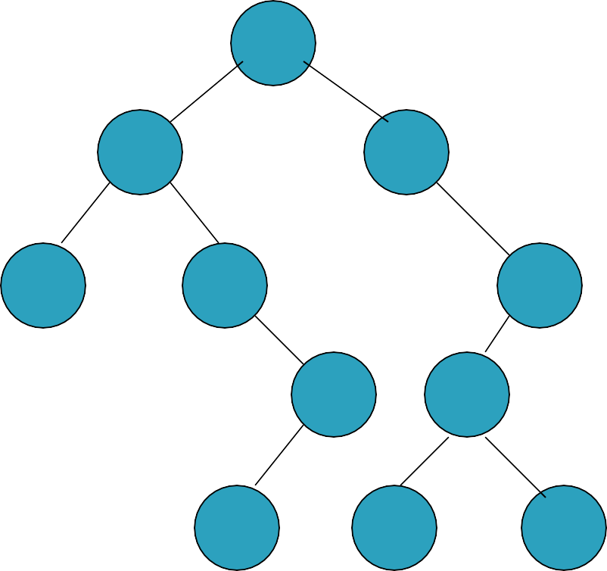
60
Delete 80
20
70
10
30
110
50
90
40
80
100

Slide 145
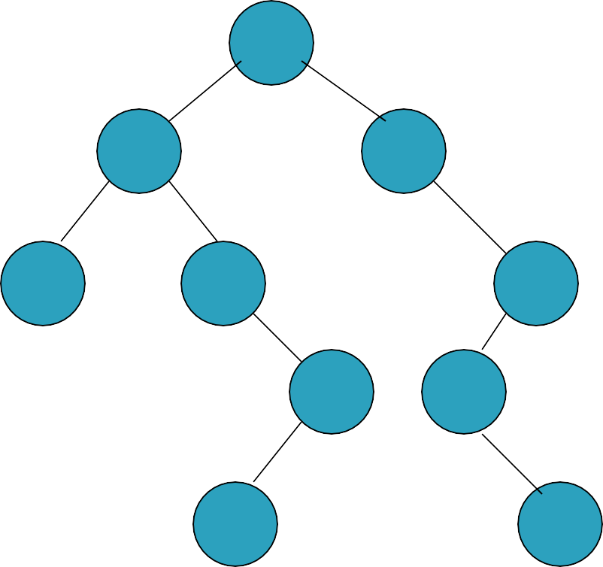
60
Delete 80
20
70
10
30
110
50
90
40
100

Slide 146
60
Delete 80
Delete 40
20
70
10
30
110
50
90
40
100

Slide 147
60
Delete 80
Delete 40
Delete 50
20
70
10
30
110
50
90
100

Slide 148
60
Delete 80
Delete 40
Delete 50
20
70
10
30
110
90
100

Slide 149

 Node to be deleted has one child.
 Remove the node, and place its child (along
with its subtree) in its place.
 The parent will be linked with the child of the deleted node.

Slide 150
60
Delete 110
20
70
10
30
110
50
90
40
80
100
15
0

Slide 151
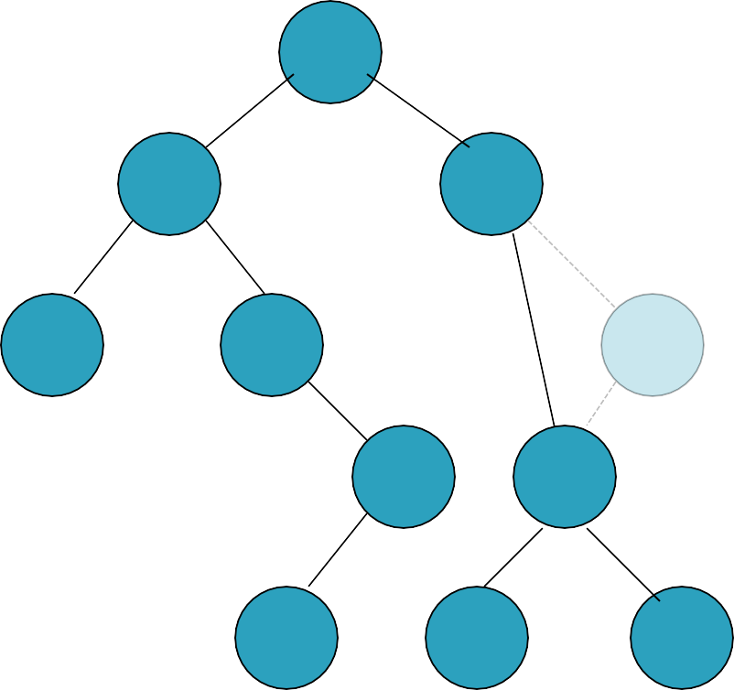
60
Delete 110
20
70
10
30
110
50
90
40
80
100

Slide 152
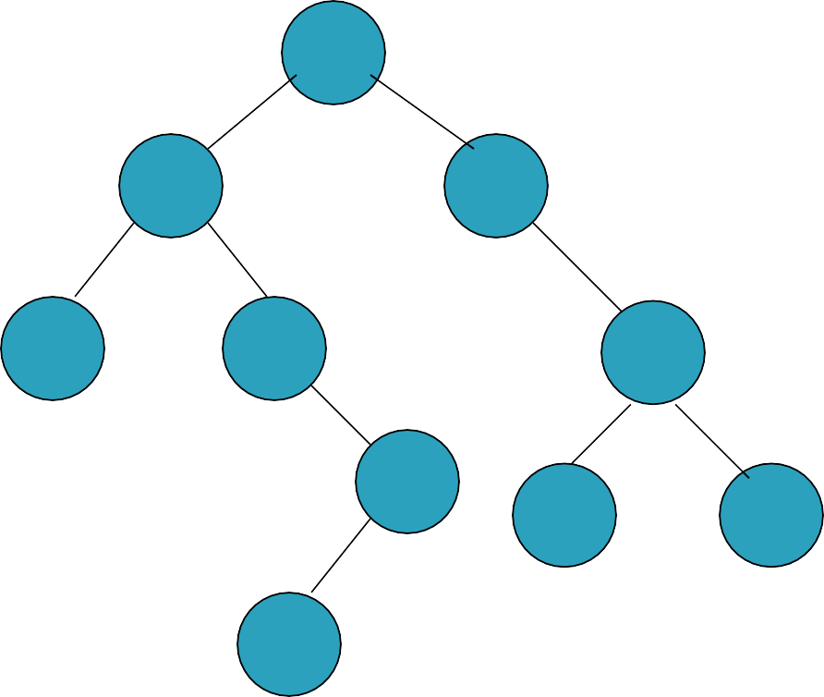
60
Delete 110
20
70
10
30
90
50
80
100
40

Slide 153
60
Delete 110
Delete 30
20
70
10
30
90
50
80
100
40

Slide 154
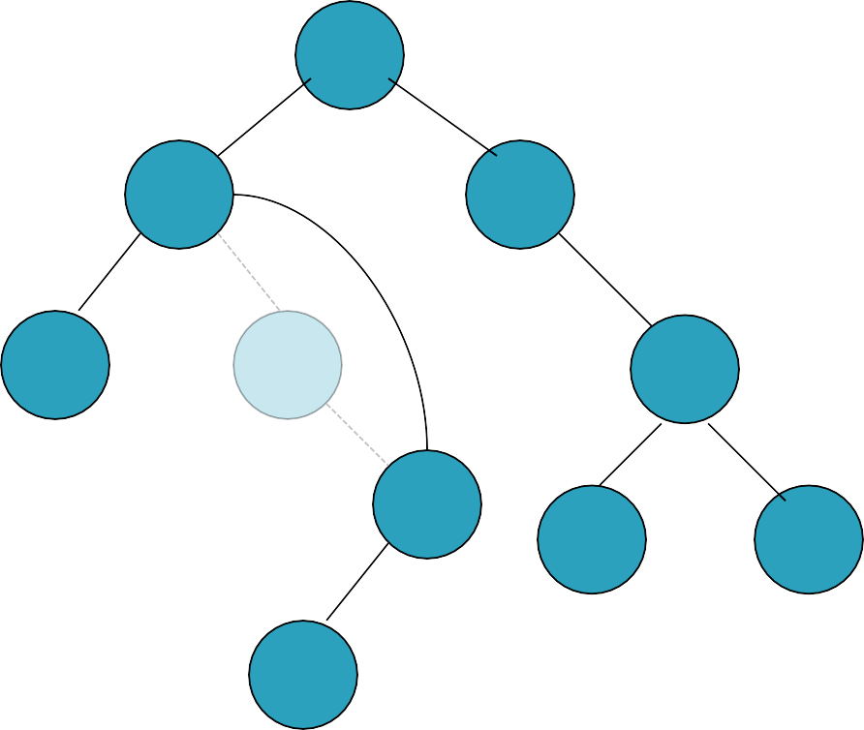
60
Delete 110
Delete 30
20
70
10
30
90
50
80
100
40

Slide 155
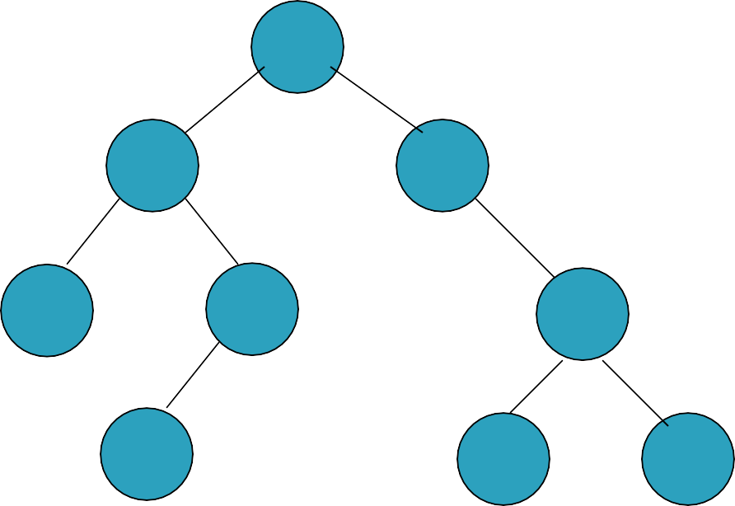
60
Delete 110
Delete 30
Delete 50
20
70
10
50
90
40
80
100

Slide 156
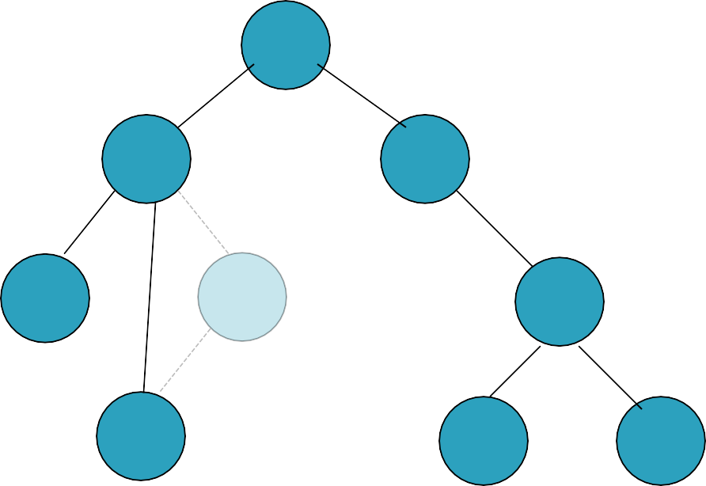
60
Delete 110
Delete 30
Delete 50
20
70
10
50
90
40
80
100

Slide 157
60
Delete 110
Delete 30
Delete 50
20
70
10
40
90
80
100

Slide 158

 Node to be deleted has two children.
 Complex case:
Find the node with the minimum key in the right subtree (left-most node in the right subtree).
Copy its key/data over the node to be deleted.
Delete the duplicate node (using either Case 1 or 2)
 The node will be overwritten by the minimum node in the right subtree. Then that duplicate node will be deleted.

Slide 159
Delete 60
60
20
70
10
30
110
50
90
40
80
100

Slide 160
Delete 60
find min in right subtree
60
20
70
10
30
110
50
90
40
80
100
16
0

Slide 161
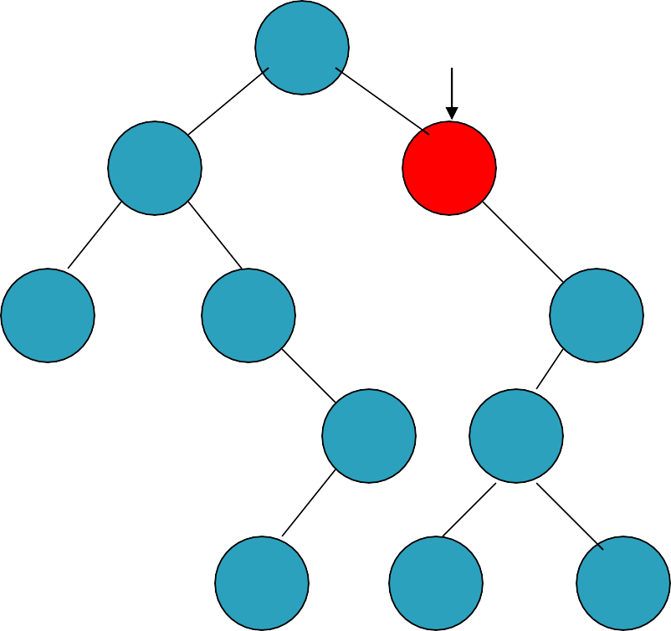
Delete 60
find min in right subtree
60
min
20
70
10
30
110
50
90
40
80
100

Slide 162

Delete 60
copy key/data
70
min
20
70
10
30
110
50
90
40
80
100

Slide 163

Delete 60
delete duplicate 70 in right subtree
70
20
70
10
30
110
50
90
40
80
100

Slide 164
delete duplicate 70 in right subtree
delete
70
Delete 60
(case 2)
20
70
10
30
110
50
90
40
80
100

Slide 165

delete duplicate 70 in right subtree
delete
70
Delete 60
(case 2)
20
70
10
30
110
50
90
40
80
100

Slide 166
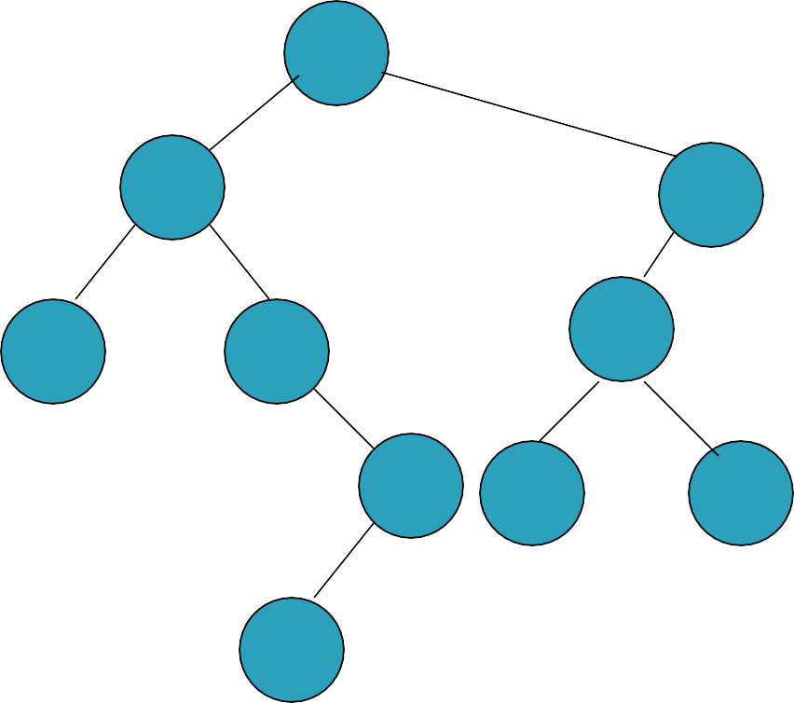
Delete 60
70
20
110
10
30
90
50
80
100
40

Slide 167
70
Delete 60
Delete 90
20
110
10
30
90
50
80
100
40

Slide 168
Delete 60
Delete 90
70
20
110
find min in right subtree
10
30
90
50
80
100
40

Slide 169
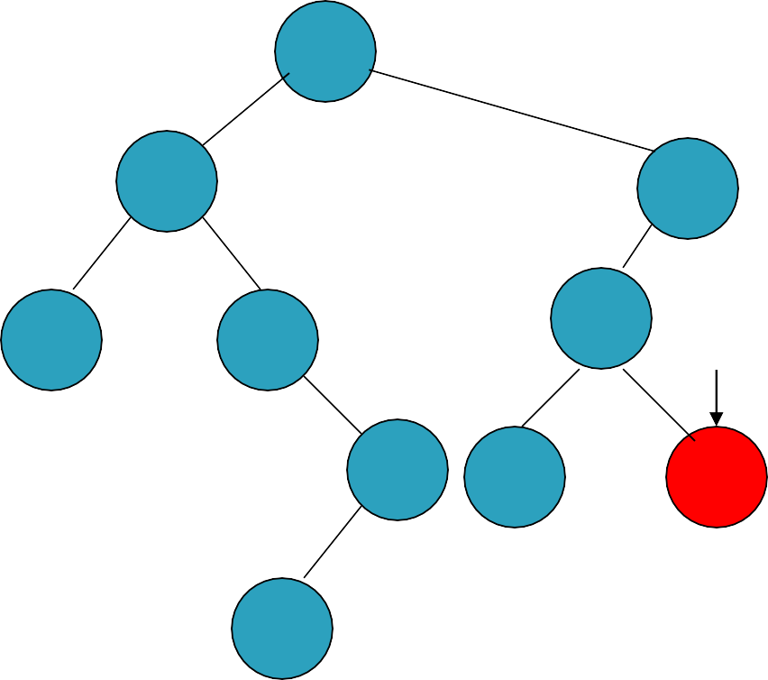
Delete 60
Delete 90
70
20
110
find min in right subtree
10
30
90
min
50
80
100
40

Slide 170

Delete 60
Delete 90
70
20
110
copy key/data
10
30
100
min
50
80
100
40
17
0

Slide 171
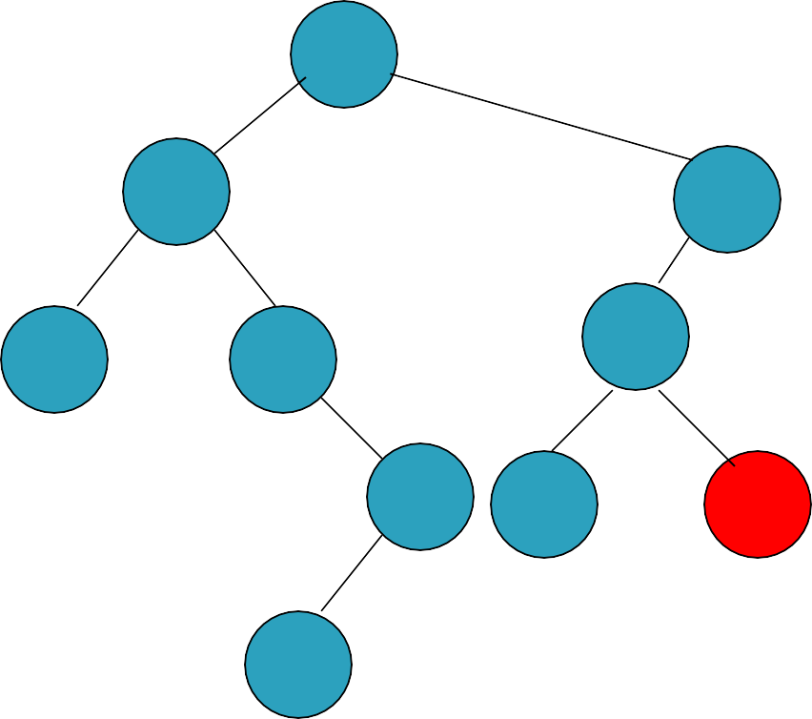
Delete 60
Delete 90
70
20
110
delete duplicate 100 in right subtree
10
30
100
50
80
100
40

Slide 172

Delete 60
Delete 90
70
20
110
delete duplicate 100 in right subtree
10
30
100
delete (case 1)
50
80
100
40

Slide 173
70
Delete 60
Delete 90
20
110
10
30
100
50
80
40

Slide 174
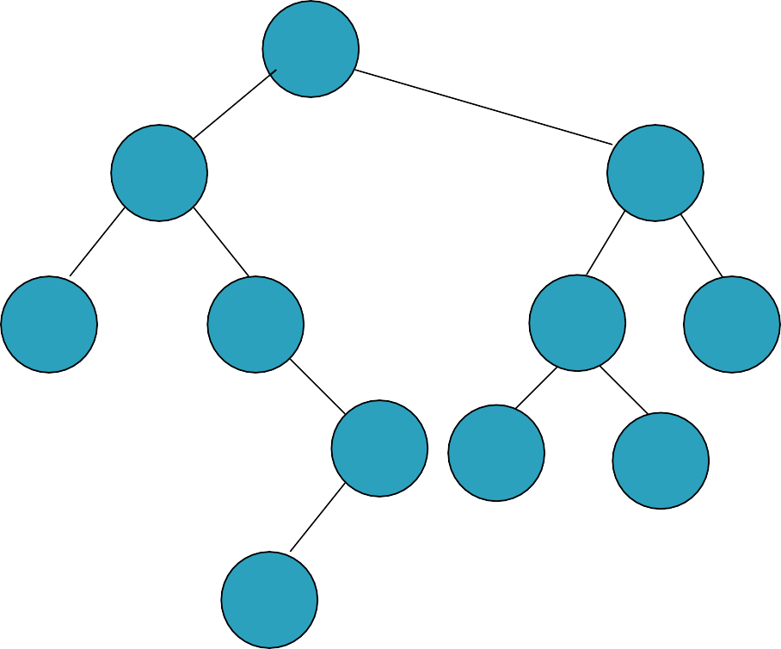
Delete 60
60
20
100
10
30
80
110
50
70
90
40

Slide 175
Delete 60
find min in right subtree
60
20
100
10
30
80
110
50
70
90
40

Slide 176
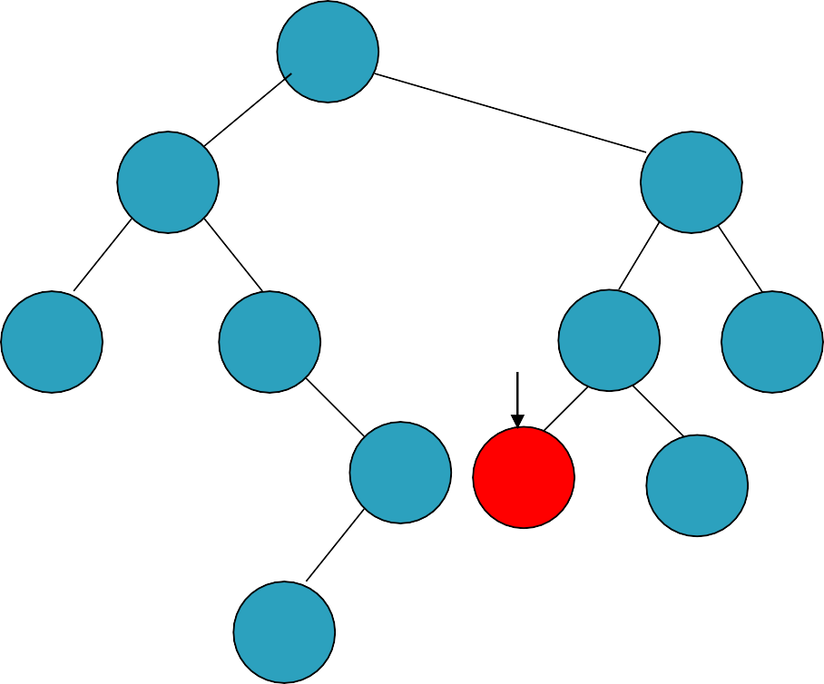
Delete 60
find min in right subtree
60
20
100
10
30
80
110
min
50
70
90
40

Slide 177
Delete 60
copy key/data
70
20
100
10
30
80
110
min
50
70
90
40

Slide 178

Delete 60
delete duplicate 70 in right subtree
70
20
100
10
30
80
110
50
70
90
40

Slide 179

Delete 60
delete duplicate 70 in right subtree
70
20
100
10
30
delete (case 1)
80
110
50
70
90
40

Slide 180
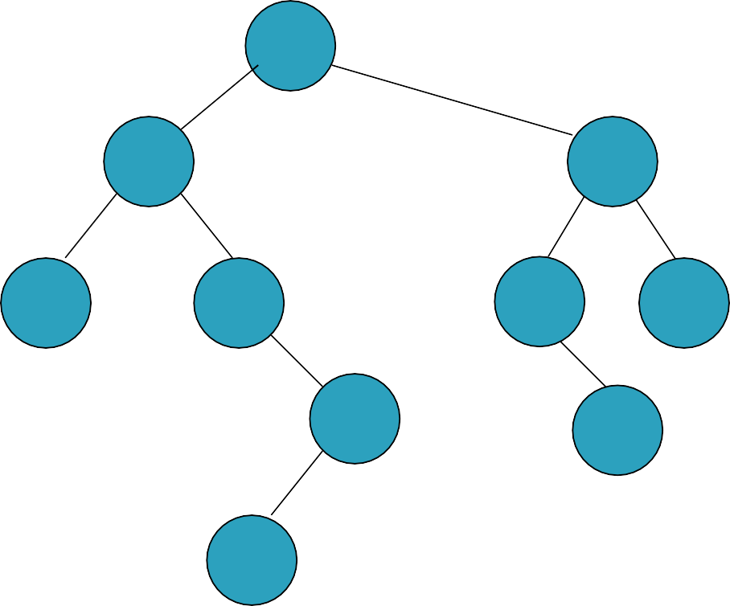
Delete 60
70
20
100
10
30
80
110
50
90
40
18
0

Slide 181
public boolean remove_key (int tkey){ Boolean removed = new Boolean(false); BSTNode<T> p;
p = remove_aux(tkey, root, removed); current = root = p;
return removed;
}

Slide 182
public boolean remove_key (int tkey){ Boolean removed = new Boolean(false); BSTNode<T> p;
p = remove_aux(tkey, root, removed);
current = root = p;
return removed;
Traverse the tree to find the key
and handle remove cases (all 3 cases). If found, it will remove and set removed to (true). Otherwise, removed
will not change (false).
The method will return the modified tree.
}

Slide 183
private BSTNode<T> remove_aux(int key, BSTNode<T> p, Boolean flag) { BSTNode<T> q, child = null;
if(p == null)
return null; if(key < p.key)
p.left = remove_aux(key, p.left, flag); //go left else if(key > p.key)
p.right = remove_aux(key, p.right, flag); //go right
else {
flag = true;
if (p.left != null && p.right != null){ //two children q = find_min(p.right);
p.key = q.key;
p.data = q.data;
p.right = remove_aux(q.key, p.right, flag);
}

Slide 184
else {
if (p.right == null) //one child
child = p.left;
else if (p.left == null) //one child child = p.right;
return child;
}
}
return p;
}

Slide 185
private BSTNode<T> find_min(BSTNode<T> p){
if(p == null)
return null;
while(p.left != null){
p = p.left;
}
return p;
}
Find left-most node (minimum key node) in any tree p

Slide 186
public boolean update(int key, T data){
remove_key(current.key); return insert(key, data);
}
}
To update the current key/value: 1). Remove the current node.
2). Insert a new node with the new key/data.
Note: The new node will be set the current after insert.

